Slide 1

5. Differential Expression Analysis in scRNAseq
Jose Alejandro Romero Herrera
Data Scientist

Slide 2
Agenda. Postprocessing
Quality control
Dimensionality reduction and Visualization
R language-Seurat
Clustering
Batch correction
DEG analysis
GREAT, PANTHER, GOrilla, DAVID
GO-term and pathway analysis
Slingshot
Pseudotime
Notes:
Glossary of single cell terms: https://nbisweden.github.io/single-cell-pbl/glossary_of_terms_single_cell.html
R language: https://www.r-project.org/ https://rstudio.com/
Seurat: https://satijalab.org/seurat/
GREAT: http://great.stanford.edu/public/html/
PANTHER: http://www.pantherdb.org/
GOrilla: http://cbl-gorilla.cs.technion.ac.il/
DAVID: https://david.ncifcrf.gov/
Diffusion maps: https://www.sciencedirect.com/science/article/pii/S1063520306000546
Slingshot: https://bmcgenomics.biomedcentral.com/articles/10.1186/s12864-018-4772-0

Slide 3
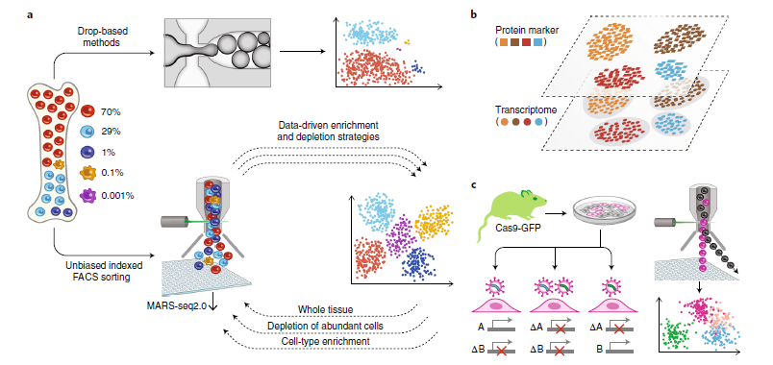
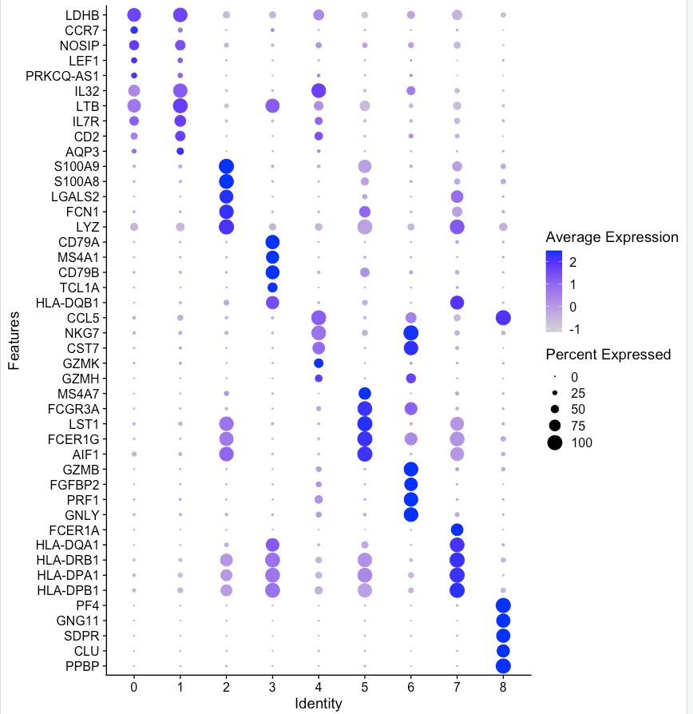
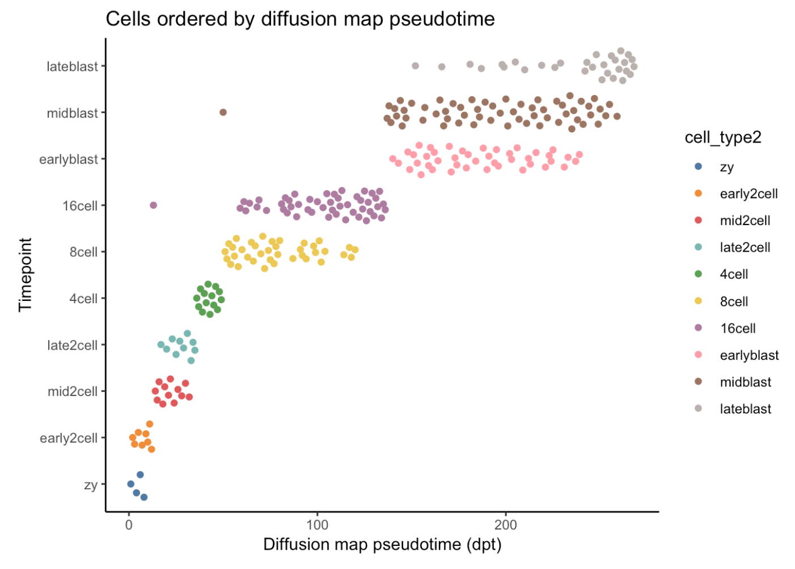
Workflow
Batch correction
QC
SC experiment
DE
Enrichment analysis
Clustering
Dimensionality reduction
Visualization
Pseudotime

Slide 4
Differential Gene Expression Analysis
Comparison between conditions or clusters
As for bulk RNAseq, Log₂ Fold Changes and p-values are calculated
Statistical testing is a bit different than for bulk RNAseq (Wald test)
Common test is Wilcoxon test (Mann Whitney)
Clusters

Slide 5
Differential Gene Expression Analysis
Testing of thousands of genes: p-values need to be adjusted
Benjamini-Hochberg method
Bonferroni method: recommended
Filter markers by LFC and adjusted p-value
Gene | p-value | Avg_log2FC | Pct.1 | Pct.2 | Adj p-value
Gm11517 | 1.107520e-16 | 1.755328 | 1 | 0.975 | 2.277726e-12
Impdh2 | 2.399680e-21 | 1.683743 | 1 | 0.992 | 4.935181e-17
Larp4 | 2.697206e-19 | 1.664780 | 1 | 0.987 | 5.547075e-15
Odc1 | 3.235495e-22 | 1.621770 | 1 | 1.000 | 6.654119e-18

Slide 6
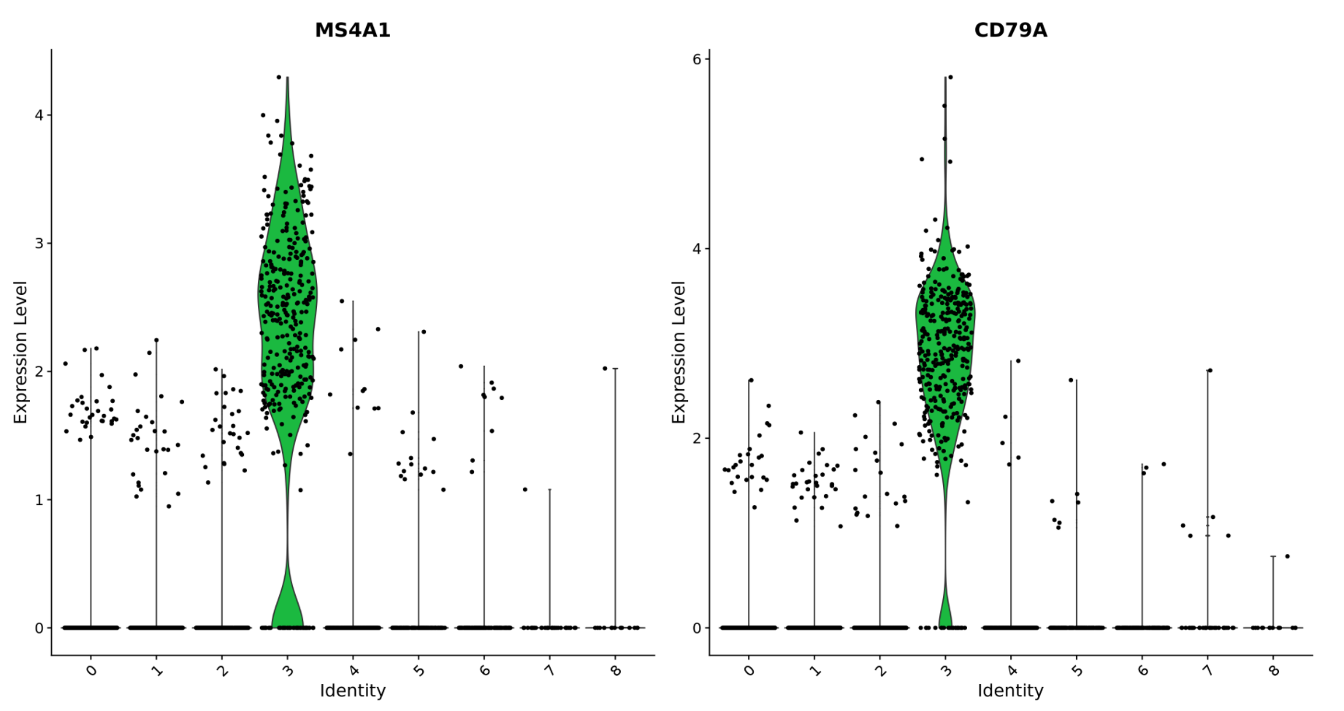
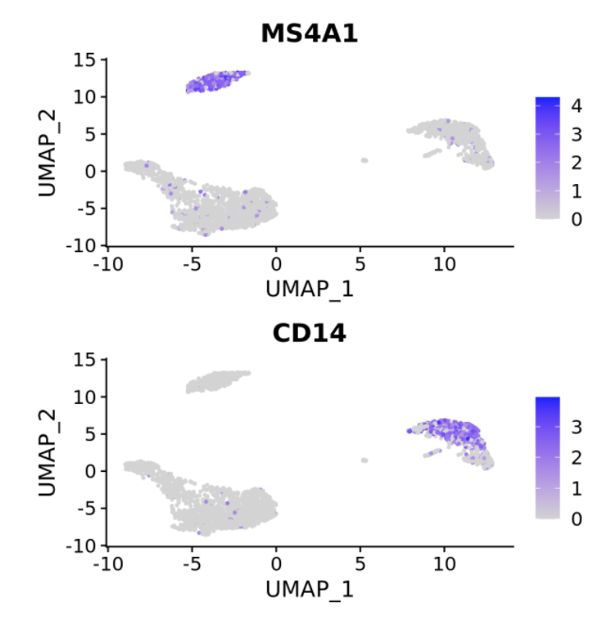
Differential Gene Expression Analysis
It is possible to produce a list of ”markers” per condition or cluster
Markers and their expression can be visualized in different ways
Dropouts!

Slide 7
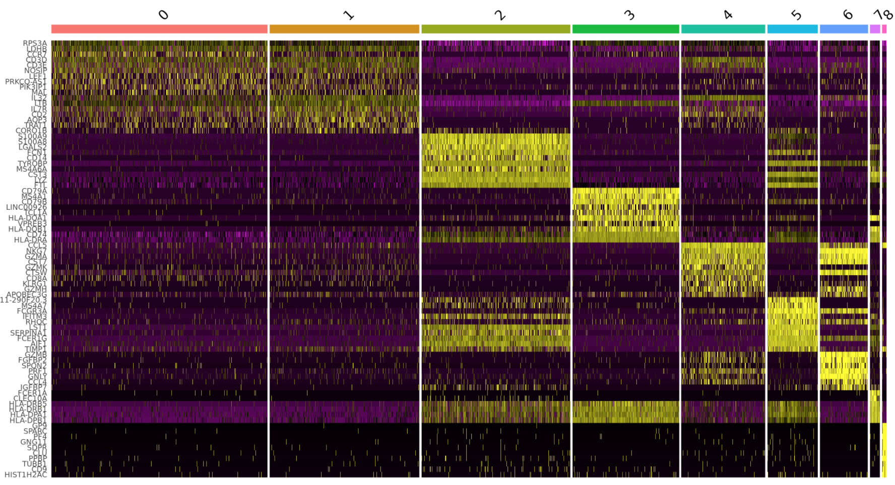
Differential Gene Expression Analysis

Slide 8
Differential Gene Expression Analysis
Clusters can be annotated using markers with previous knowledge
No annotation
Annotated

